Slide 1
Terro’s REAL estate agency Business report .

Slide 2
1.Generating the summary statistics for each variable in the table. (Using Data analysis tool pack). With observations.
Approach : particularly I have selected the first data variable in the table which is Crime rate with whole data .
Selected ->clicked Data Tab on the menu ->selected data analysis Tab -> selected descriptive analysis and selected the range from crime rate and marked the summary statics to the
Expected result.
After getting the expected result moved to the new sheet named task1.
So same thing done to the every other data variable in the table inserted in the output page .

Slide 3
Observation:
CRIME_RATE: The average crime rate is 4.87, with values ranging from 0.04 to 9.99. Most values are concentrated towards the lower end, but some higher values exist, indicating moderate variability.
AGE: The average age of houses is 68.57, with houses ranging from 2.90 to 100. This suggests that there are mostly older houses in the area, with considerable age variation.
INDUS: The proportion of non-retail business acres ranges from 0.46 to 27.74, with an average of 11.14. The data shows moderate variability, indicating variations in non-retail business acreage.
DISTANCE: The distance to employment centers ranges from 1 to 24 miles, with an average of 9.55. This indicates houses are located at varying distances from employment centers.
ROOMS: The average number of rooms in houses ranges from 3.56 to 8.78, with an average of 6.28. This suggests variation in house sizes based on the number of rooms.
Data distribution: The values of each variable have wide ranges, indicating significant differences. Some variables have non-normal distribution with high skewness and kurtosis values, suggesting non-uniformity. High standard deviation values indicate high variability in the data, further supporting the presence of variations in the variables.

Slide 4
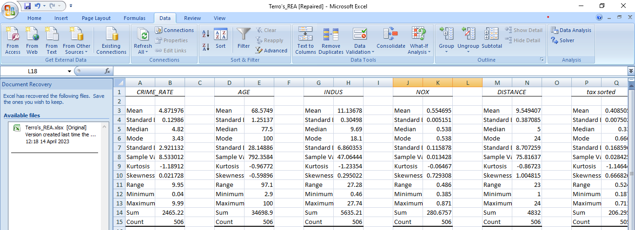

Slide 5
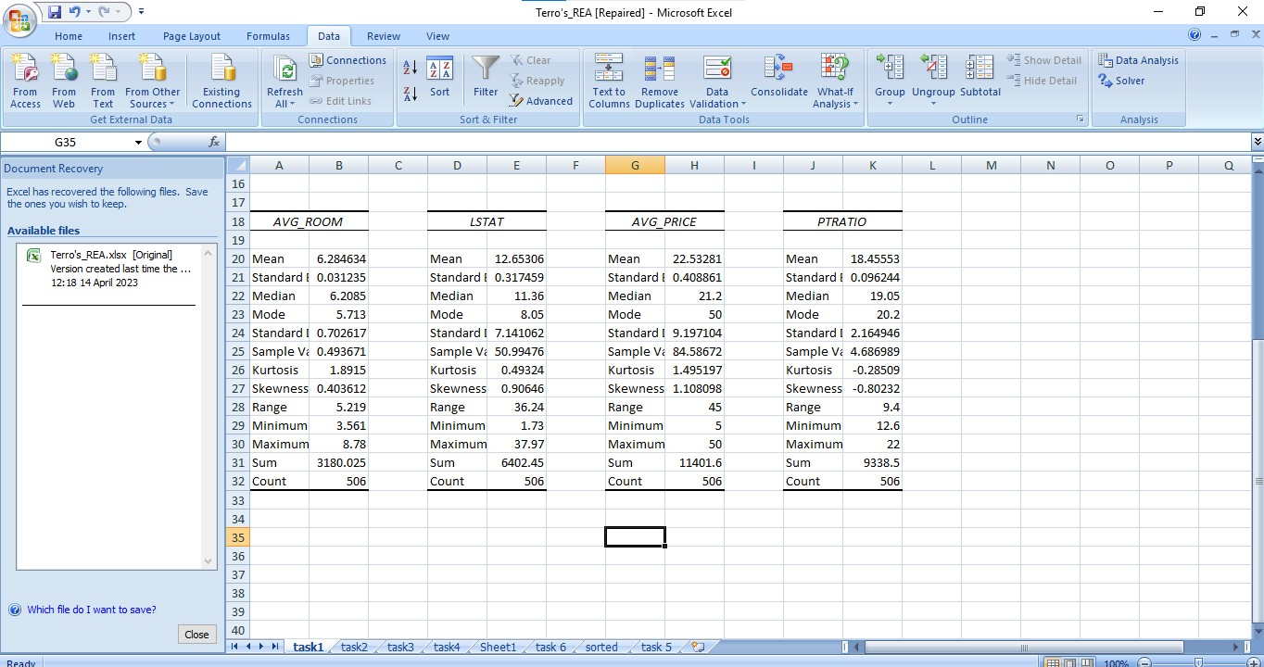

Slide 6
2.Plot a histogram of the Avg_Price variable.
Approach : I have selected the Avg_price data variable in the table with whole data .
Selected ->clicked Data Tab on the menu ->selected data analysis Tab -> selected histogram and selected the range and clicked ->Ok .
After generating the frequency and bin selected the both variables using that created the chart.

Slide 7
Infer:
The data in the table ranges from 5 to 50.
There are two peaks in the histogram at values 70 and 77, with corresponding bin values of 23.4 and 21.3, suggesting the presence of two subpopulations.
The histogram shows a slight skew towards the right, as most values have the highest frequency.
There are some low frequency values, indicating possible outliers in the data.
The graph displays the frequency values on both axes.

Slide 8
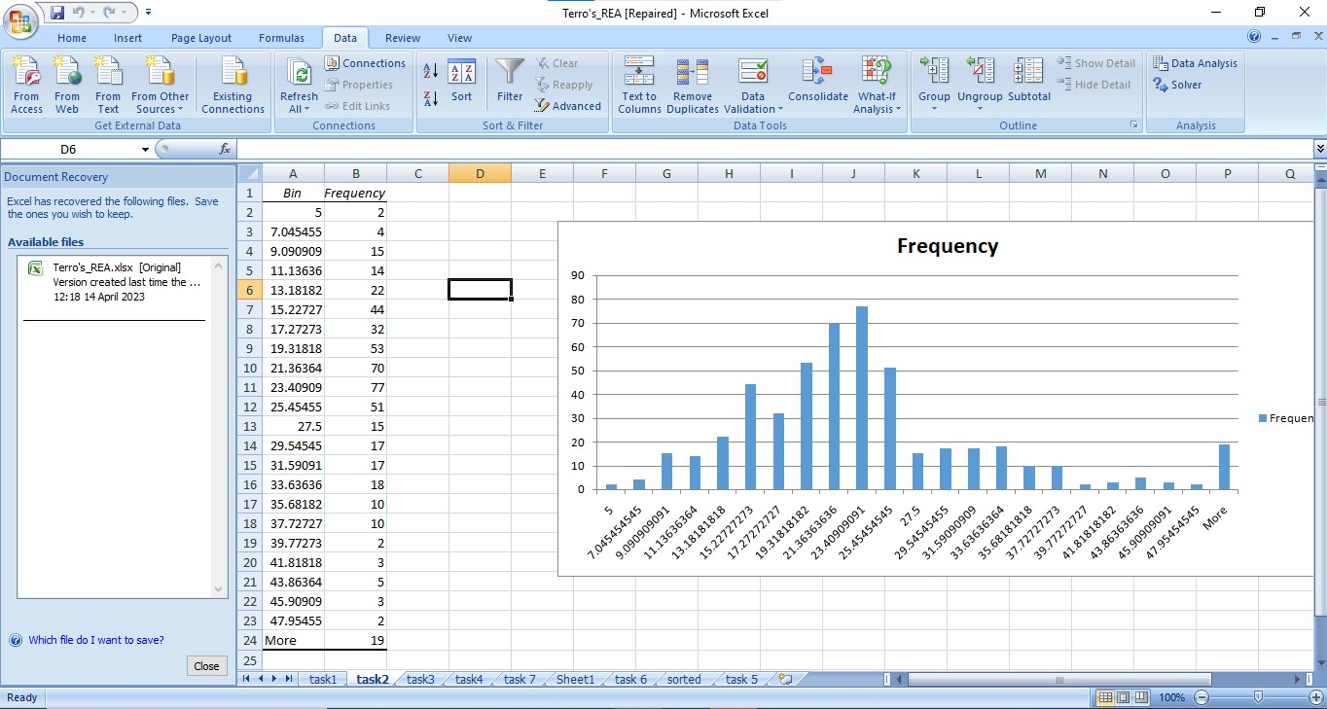

Slide 9
3.Computing the covariance matrix.
Approach : I have selected the whole data variable in the table.
Selected ->clicked Data Tab on the menu ->selected data analysis Tab -> selected covariance and selected the range and clicked ->Ok .
Succesfully generated the covariance matri table

Slide 10
Covariance with observation:
The magnitude of the covariance shows the strength of the relationship between the variables. The positive covariance shows the, the variables vary in same direction and the negative covariance shows that the variables vary in opposite direction.

Slide 11
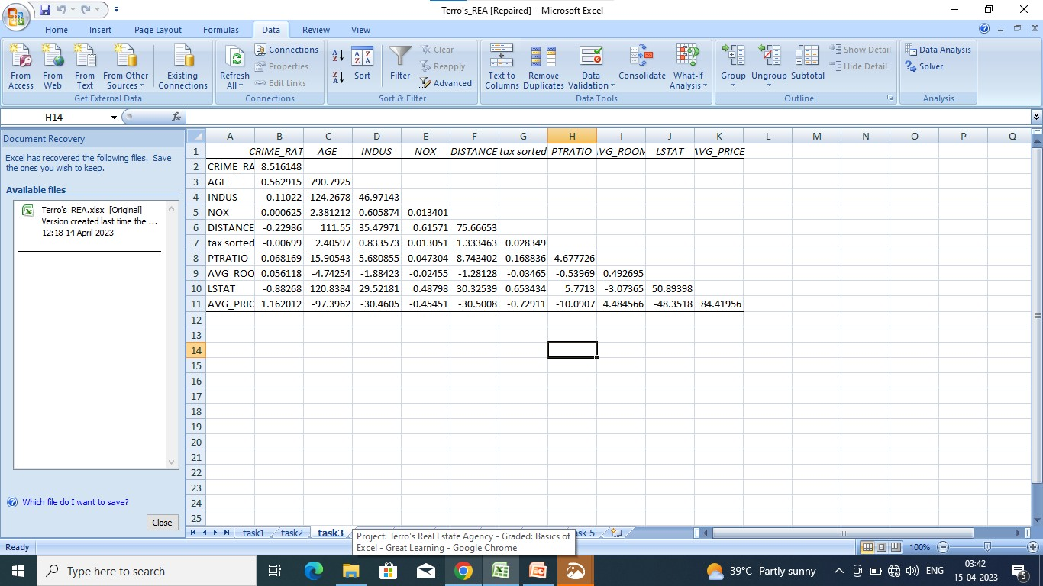

Slide 12
4. Creating a correlation matrix of all the variables
Approach : I have selected the whole data variable in the table.
Selected ->clicked Data Tab on the menu ->selected data analysis Tab -> selected correlation and selected the range and clicked ->Ok .
Succesfully generated the correlation matrix table

Slide 13
a. The top three positively correlated pairs are
TAX and DISTANCE(0.91023)
INDUS and NOX(0.76365 )
AVG_ROOM and AVG_PRICE(0.69536 )
b. Top 3 negatively correlated pair: 1. CRIME_RATE and INDUS(-0.00551) 2. CRIME_RATE and DISTANCE(-0.00906) 3. CRIME_RATE and LSTAT(-0.04240)

Slide 14
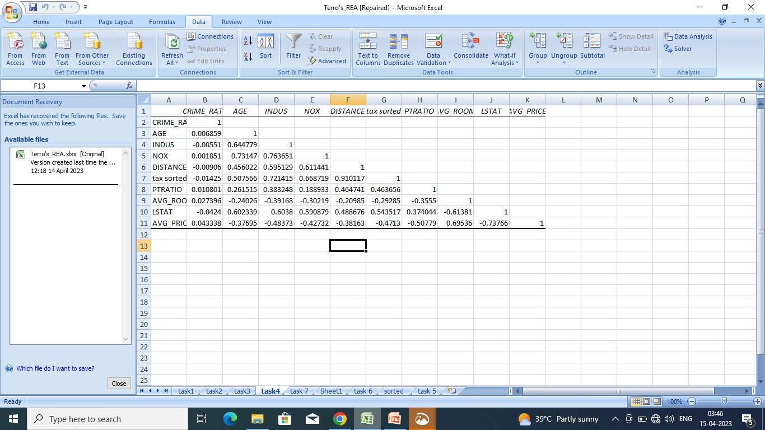

Slide 15
5.Building an initial regression model with AVG_PRICE as ‘y’ (Dependent variable) and LSTAT variable as Independent Variable. Generating the residual plot as well.
Approach : I have selected AVG_PRICE and LSTAT variable in the table.
Selected ->clicked Data Tab on the menu ->selected data analysis Tab -> selected regression and selected the range AVG_PRICE as ‘y’and LSTAT variable as Independent Variable as x in the table and clicked ->Ok .
Generated the summary output ,residual plots for LSTAT scatter chart as well.
Observation:
The regression summary shows that there is a positive linear relationship between the explanatory variable LSTAT and the response variable.
The coefficient of LSTAT is -0.950, meaning that for every one unit increase in LSTAT, the response variable decreases by 0.950 units.
The intercept of 34.554 represents the mean value of the response variable when LSTAT is zero.
The regression model is significant at a 5% level of significance, indicating that the predictor variable (LSTAT) is important in explaining the variability of the response variable.

Slide 16
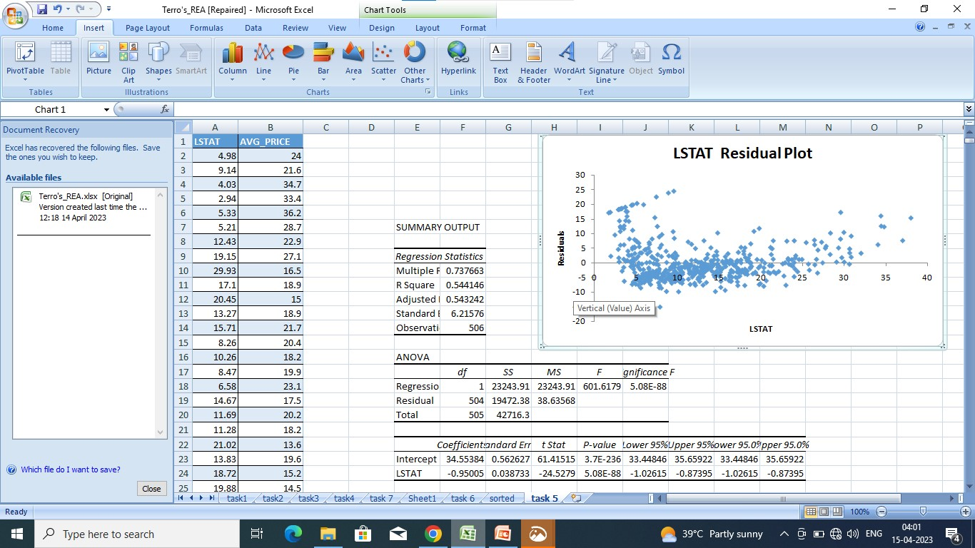

Slide 17
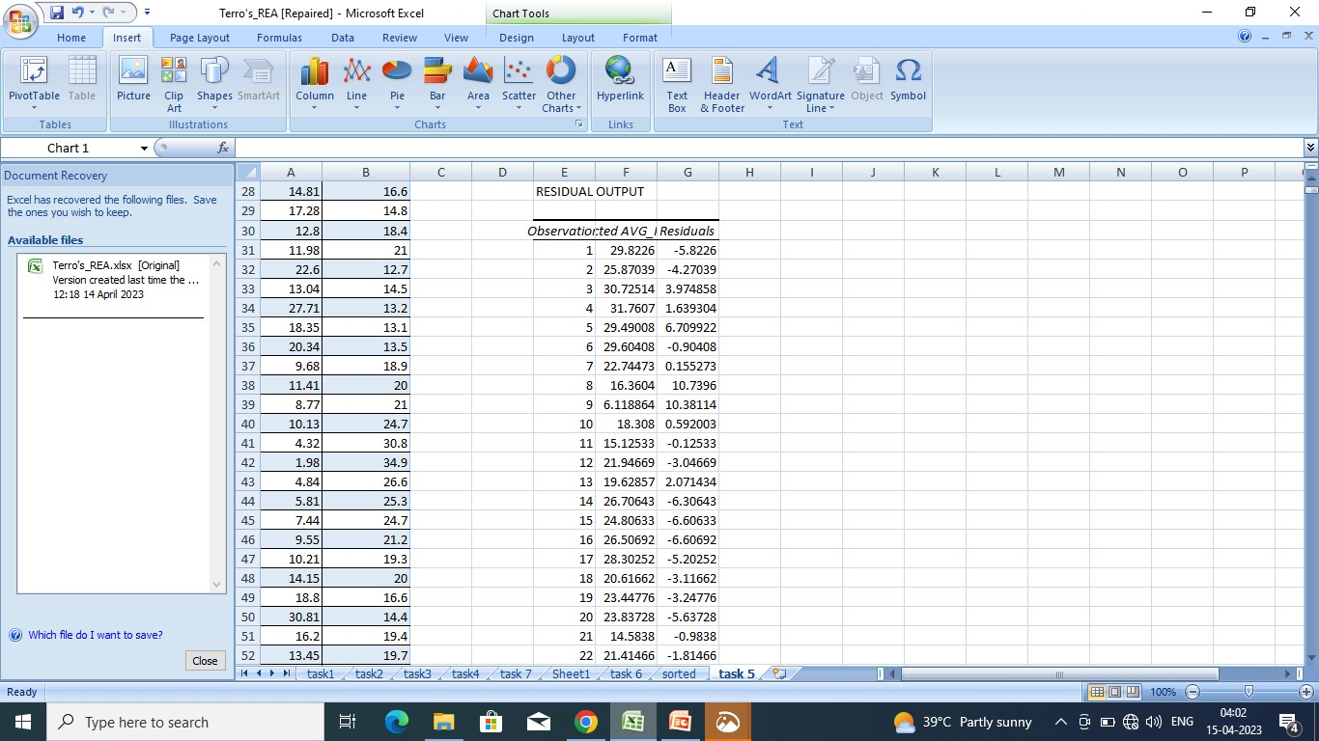

Slide 18
6.Building a new Regression model including LSTAT and AVG_ROOM together as Independent variables and AVG_PRICE as dependent variable.
Approach : I have selected AVG_ROOM and LSTAT, AVG_PRICE variable in the table.
Selected ->clicked Data Tab on the menu ->selected data analysis Tab -> selected regression and selected the range AVG_ROOM and LSTAT variable as Independent Variable as x, and AVG_PRICE as dependent variable as y. in the table .
The regression equation of the model is:
AVG_PRICE = -1.358 + 5.095 * AVG_ROOM - 0.642 *LSTAT
To calculate the predicted value of AVG_PRICE for a new house with 7 rooms and an L-STAT value of 20, we substitute these values in the above equation:
AVG_PRICE = -1.358 + 5.095 * 7 - 0.642 * 20 = 25.053
Therefore, the predicted value of AVG_PRICE for the given input values is 25.053.

Slide 19
Comparing this with the company's quote of 30000 USD, we can say that the company is undercharging as the predicted value of AVG_PRICE is lower than the quoted price.
However, it is important to note that the regression model is based on historical data and may not capture all factors that can affect house prices. So, the actual price may vary from the predicted value.
Comparison:
Yes, the performance of this model is better than the model that is built on the previous question.
The performance of this model can be evaluated by looking at the R-squared value. In previous model the R-squared value of 0.5441 indicates that 54.41% of the variance in the average price(dependent) can be explained by the LSTAT variable(independent). However, the remaining 45.59% of the variability is unexplained.
Whereas, The R-squared value of this model is 0.639, indicates 63.9% of the variance in the average price(dependent) is explained by the average room and LSTAT(independent).
The model seems to perform well that the previous model as both R-squared and adjusted R-squared values are relatively high.

Slide 20
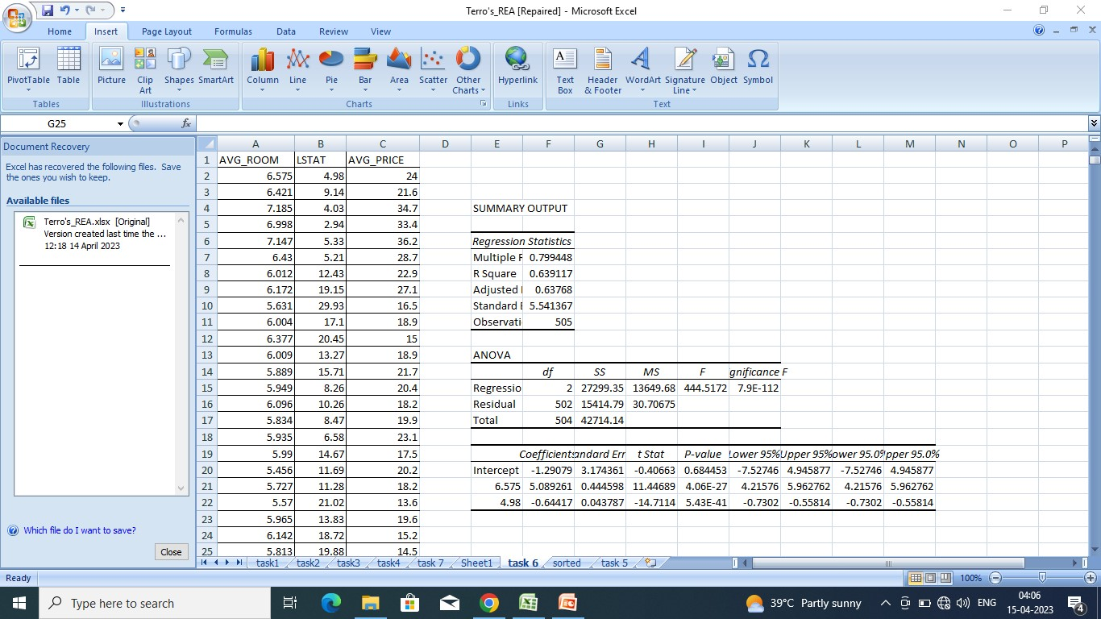

Slide 21
7) Build another Regression model with all variables where AVG_PRICE alone be the Dependent Variable and all the other variables are independent.
Approach : I have selected AVG_PRICE and all the other variable in the table.
Selected ->clicked Data Tab on the menu ->selected data analysis Tab -> selected regression and selected the range AVG_PRICE as dependent variable as y. And all other data variable as independent as x in the table and clicked ->Ok .
Generating the coefficient and Intercept values.
Output:

Slide 22
The multiple regression model has a good fit, with an adjusted R square of 0.688, indicating that approximately 68.8% of the variance in AVG_PRICE is explained by the independent variables. The coefficients for each independent variable show the impact of a one-unit change in that variable, while keeping other variables constant. The intercept value of 29.24 represents the expected value of AVG_PRICE when all independent variables are zero.
The coefficients for each independent variable:
CRIME_RATE: The coefficient of 0.049 suggests that there is almost no relationship between crime rate and AVG_PRICE, as the variable is not significant in predicting the dependent variable, as indicated by the p-value of 0.535.
AGE: The coefficient of 0.033 indicates that for every one-unit increase in AGE, AVG_PRICE increases by $33. This variable is significant in predicting AVG_PRICE, as indicated by the p-value of 0.013.
INDUS: The coefficient of 0.131 suggests that for every one-unit increase in INDUS, AVG_PRICE increases by $131. This variable is significant in predicting AVG_PRICE, as indicated by the p-value of 0.039.
NOX: The coefficient of -10.321 indicates that for every one-unit increase in NOX, AVG_PRICE decreases by $10,321. This variable is significant in predicting AVG_PRICE, as indicated by the p-value of 0.008.

Slide 23
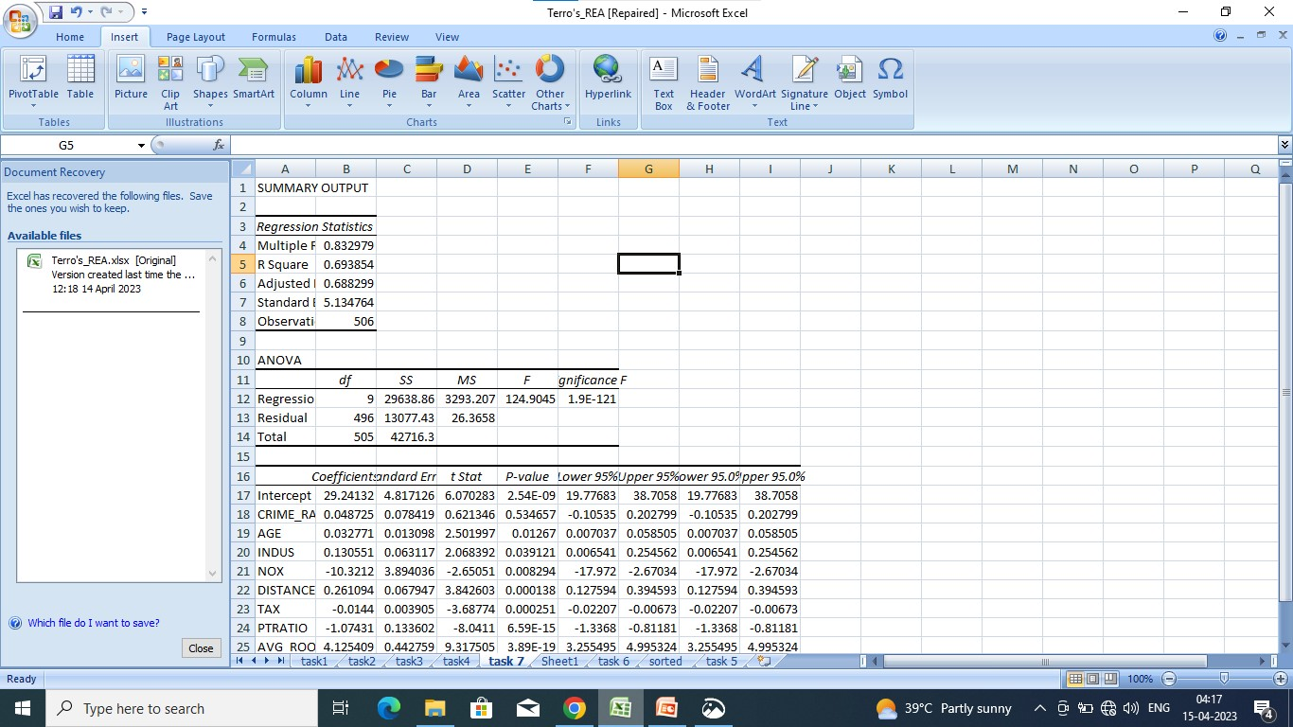

Slide 24
8.TASK
From the table, we can see that the following variables have P-values less than 0.05:
Intercept
AGE
INDUS
NOX
DISTANCE
tax in 000
PTRATIO
AVG_ROOM
LSTAT

Slide 25
The model explains 69% of the variation in the dependent variable (AVG_PRICE). The significant F-test indicates that at least one independent variable has a significant impact on the dependent variable. The intercept coefficient suggests that the average value of the dependent variable is 29.43 when all independent variables are zero. The negative coefficients for INDUS, NOX, TAX IN 000, and LSTAT indicate that as these variables increase, the dependent variable tends to decrease. On the other hand, the positive coefficients for DISTANCE, PTRATIO, and AVG_ROOM indicate that as these variables increase, the dependent variable tends to increase. This model can be used to predict the dependent variable based on the values of the independent variables.

Slide 26
The R-squared value of the current model is 0.639, which means that 63.9% of the variance in the average price (dependent variable) is explained by the average room and LSTAT (independent variables). The adjusted R-squared value is 0.6887, indicating that 68.87% of the variance in the housing prices (dependent variable) is explained by the independent variables in the model. However, it's important to note that as the number of predictors increases, the R-squared value may also increase even if the predictors do not actually improve the model's predictive power. Overall, the current model appears to perform well as both the R-squared and adjusted R-squared values are relatively high compared to the previous model.

Slide 27
END
BHARATH .J

